Slide 1

Shri Vishnu engineering college for women::Bhimavaram (Autonomous)
Handwritten Text Recognition
IV B.Tech II Sem Project power point presentation
In
Computer Science and Engineering
By
ADDANKI SAI SURYA SANJANA(18B01A0563)
M PERSIS EDITH(18B01A0577)
UNDRU AASIN(18B01A0586)
P DEEPTHI BHATNAKAR(18B01A05B2)
Under the guidance of
P. SUNIL
Asst. Professor
REVIEW NO:03
Date: 12-04-2022
Department of Computer Science and Engineering Slide No:01

Slide 2
INTRODUCTION
Despite the abundance of technological writing tools, many people still choose to take their notes traditionally: with pen and paper.
However, there are drawbacks to handwriting text. It’s difficult to store and access physical documents in an efficient manner, search through them efficiently and to share them with others.
Thus, a lot of important knowledge gets lost or does not get reviewed because of the fact that documents never get transferred to digital format.
We have thus decided to tackle this problem in our project because we believe the significantly greater ease of management of digital text compared to written text will help people more effectively access, search, share, and analyze their records, while still allowing them to use their preferred writing method.
The aim of this project is to further explore the task of classifying handwritten text and to convert handwritten text into the digital format.
Department of Computer Science and Engineering Slide No:02

Slide 3
PROBLEM STATEMENT
The purpose of this project is to take handwritten English text image as input, process each character, train the neural network algorithm, to recognize the pattern and modify the character to a beautified version of the input.
This project is aimed at developing software which will be helpful in recognizing characters of English language. It can be further developed to recognize the text of different languages. It engulfs the concept of neural network.
Department of Computer Science and Engineering Slide No:03

Slide 4
DESIGN COMPARISONS
EXISTING SYSTEM | PROPOSED SYSTEM
Handwritten Text software is Google Lens and hardware is OCR scanners already exists. But those were not accurate as expected. | With the help of an UI, User can upload an image and can get the recognized text as output.
In some other systems also they have only recognized either digits or characters. | A model for handwritten text recognition that can recognize handwriting using concepts of deep learning.
Trained the model using MNIST dataset using some basic machine learning algorithms. | Trained the model using IAM dataset using deep learning algorithms.
Machine learning algorithms have less performance | Deep Learning self extracts features with a deep neural networks and classify itself. Compare to traditional Algorithms it performance increase with Amount of Data.
Department of Computer Science and Engineering Slide No:04

Slide 5
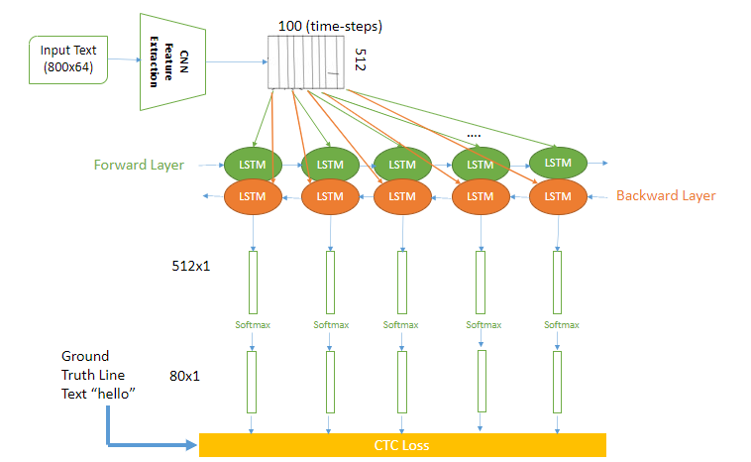
DESIGN
Department of Computer Science and Engineering Slide No:05

Slide 6
PROJECT MODULES
Data Preprocessing:
First we will look into the data set for preprocessing. Dataset is IAM Handwriting Database. The dataset contains 13,353 images of handwritten text written by 657 writers.
IAM Dataset we considered having images of individual words and images of single line sentences. We will preprocess the image starting from converting to gray scale image, removing background noise, proper filtering and smoothing of the image.
Model Building:
CNN: the input image is fed into the CNN layers.
RNN: the feature sequence contains 256 features per time-step, the RNN propagates relevant information through this sequence.
CTC: while training the NN, the CTC is given the RNN output matrix and the ground truth text and it computes the loss value.
Department of Computer Science and Engineering Slide No:06

Slide 7
PROJECT MODULES
Model Evaluation:
CNN output: Output of the CNN layers. Each entry contains 256 features. Of course, these features are further processed by the RNN layers.
RNN output: The RNN output matrix contains the scores for the characters including the CTC blank label as its last entry.
Modules:
SamplePreprocessor.py: prepares the images from the IAM dataset for the NN
DataLoader.py: reads samples, puts them into batches and provides an iterator-interface to go through the data
Model.py: creates the model as described above, loads and saves models, manages the TF sessions and provides an interface for training and inference
Main.py: puts all previously mentioned modules together
Department of Computer Science and Engineering Slide No:07

Slide 8
PROJECT MODULES
Training
The mean of the loss values of the batch elements is used to train the NN: it is fed into an optimizer such as RMSProp.
Improving the model
Data augmentation: increase dataset-size by applying further (random) transformations to the input images
Remove cursive writing style in the input images
Increase input size (if input of NN is large enough, complete text-lines can be used)
Adding more CNN layers
Replacing LSTM by 2D-LSTM
Decoder: use token passing or word beam search decoding to constrain the output to dictionary words
Text correction: if the recognized word is not contained in a dictionary, search for the most similar one
Department of Computer Science and Engineering Slide No:08

Slide 9
PROJECT MODULES
Training
The mean of the loss values of the batch elements is used to train the NN: it is fed into an optimizer such as RMSProp.
Improving the model
Data augmentation: increase dataset-size by applying further (random) transformations to the input images
Remove cursive writing style in the input images
Increase input size (if input of NN is large enough, complete text-lines can be used)
Adding more CNN layers
Replacing LSTM by 2D-LSTM
Decoder: use token passing or word beam search decoding to constrain the output to dictionary words
Text correction: if the recognized word is not contained in a dictionary, search for the most similar one
Conclusion
The NN consists of 5 CNN and 2 RNN layers and outputs a character-probability matrix. This matrix is either used for CTC loss calculation or for CTC decoding. An implementation using TF is provided and some important parts of the code were presented. Finally, hints to improve the recognition accuracy were given.
Department of Computer Science and Engineering Slide No:09

Slide 10
ATTAINMENT OF OBJECTIVES
01
An easy user interface to input the image.
02
User should be able to upload image.
03
Preprocess the given image to suppress the background.
04
Retrieve text present in the image.
05
With the help of Spellchecker, increased the accuracy and display them to the user.
Department of Computer Science and Engineering Slide No:10

Slide 11
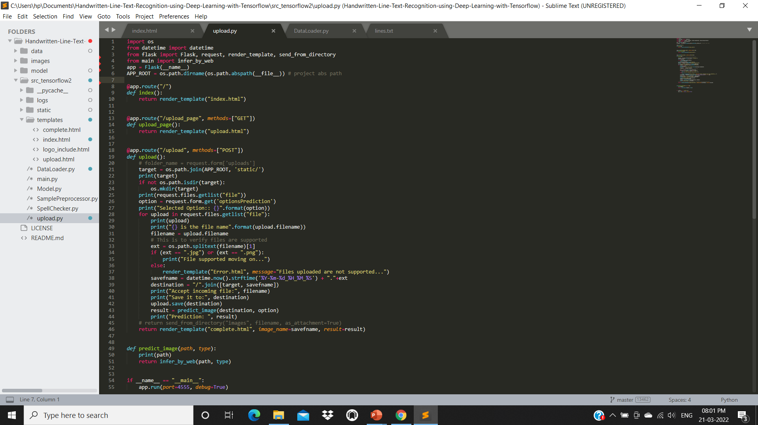

IMPLEMENTATION
Department of Computer Science and Engineering Slide No:11

Slide 12
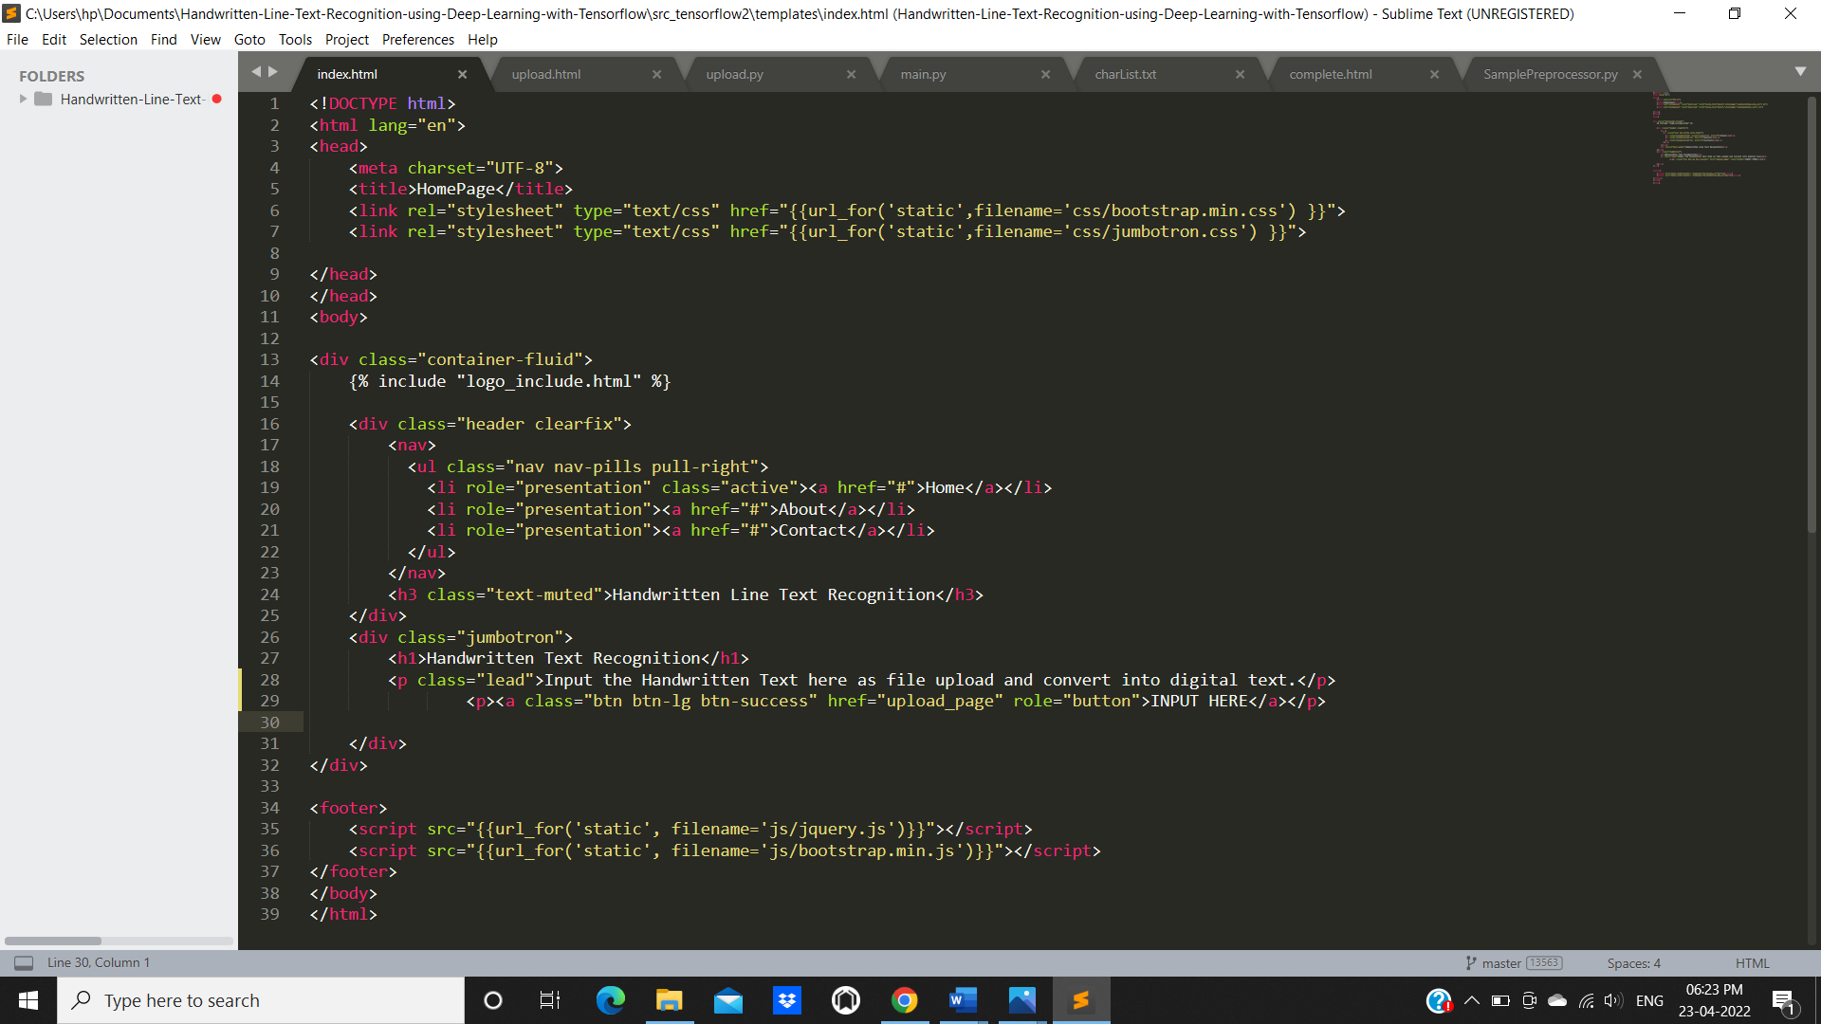
IMPLEMENTATION
Department of Computer Science and Engineering Slide No:11

Slide 13
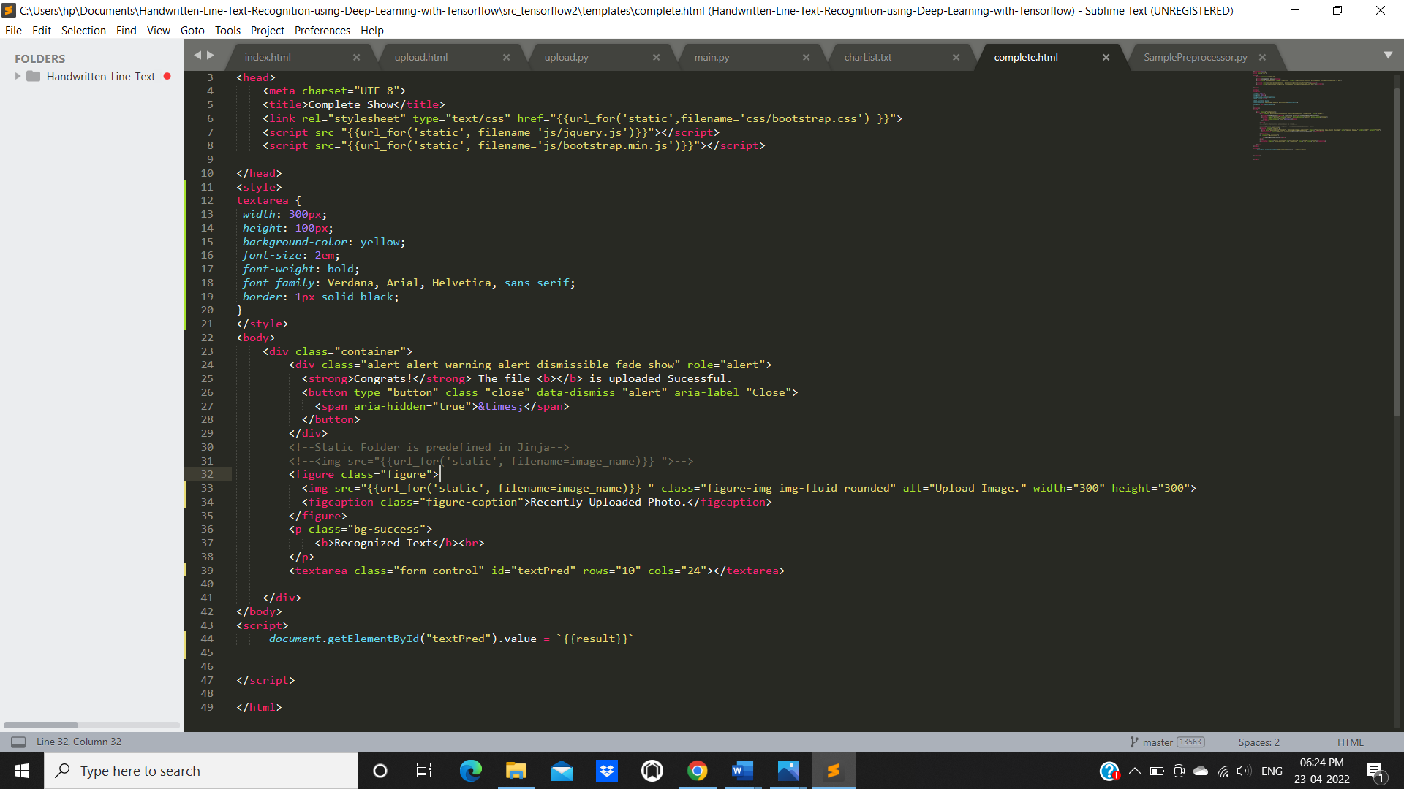
IMPLEMENTATION
Department of Computer Science and Engineering Slide No:09

Slide 14
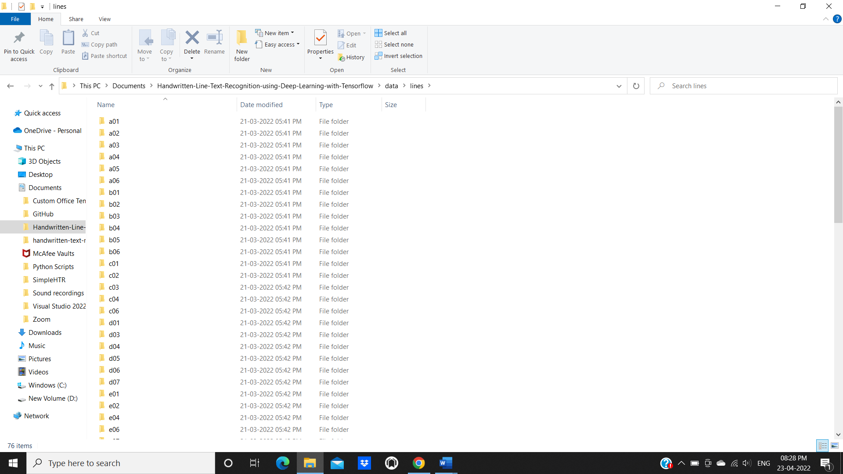
DATA SET
Department of Computer Science and Engineering Slide No:10

Slide 15
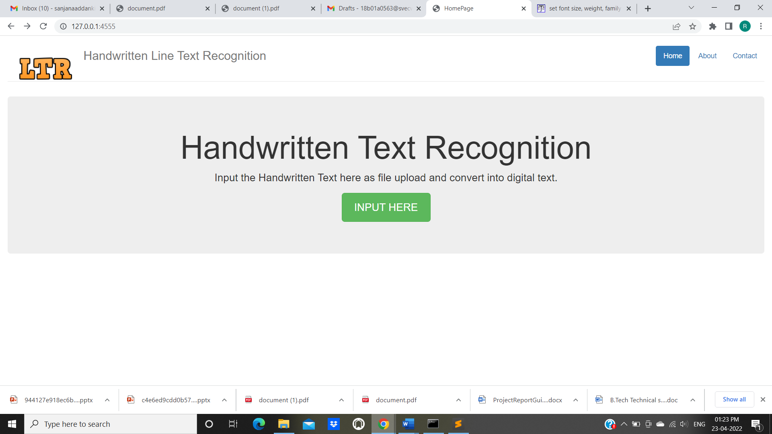
SCREENS
Department of Computer Science and Engineering Slide No:10

Slide 16
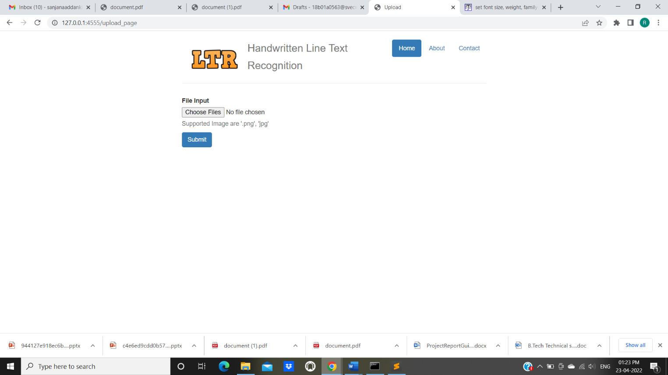
SCREENS
Department of Computer Science and Engineering Slide No:10

Slide 17
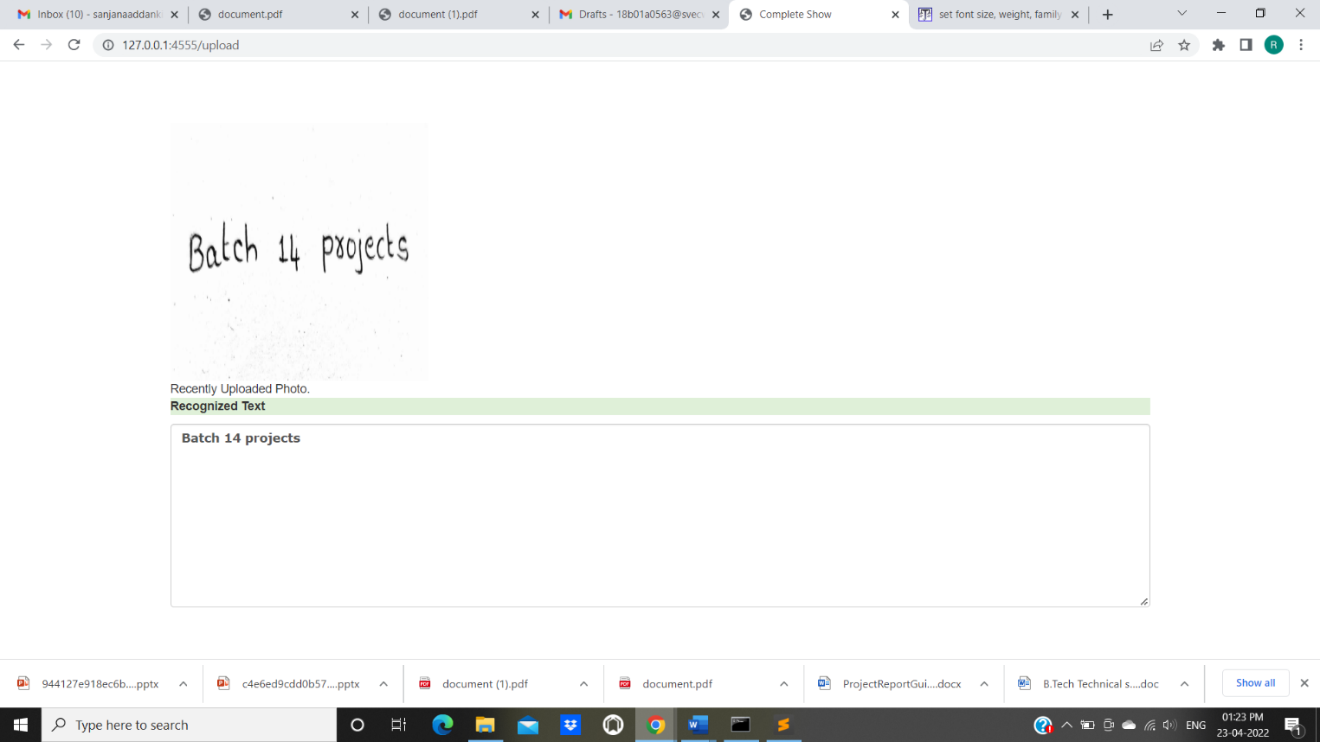
SCREENS
Department of Computer Science and Engineering Slide No:10

Slide 18
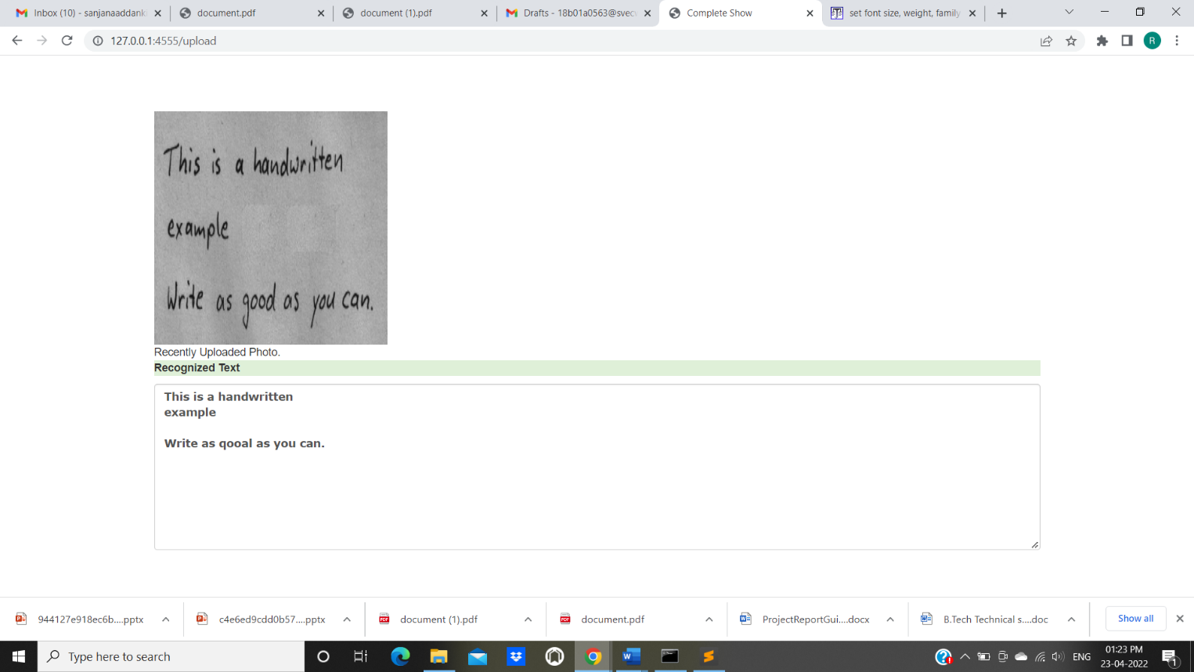
SCREENS
Department of Computer Science and Engineering Slide No:10

Slide 19
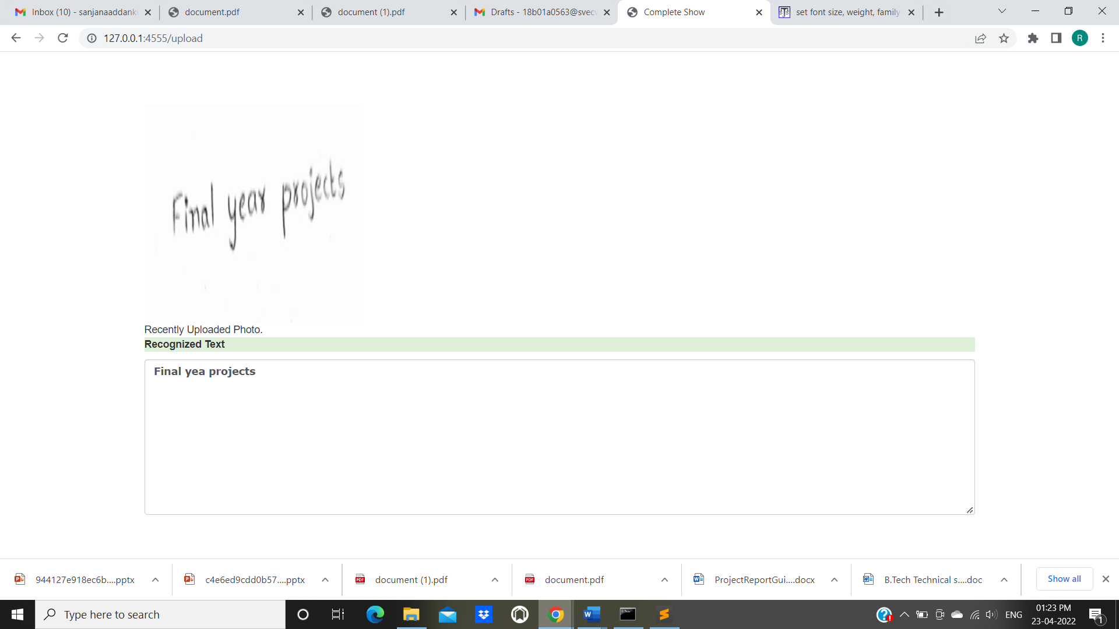
SCREENS
Department of Computer Science and Engineering Slide No:10

Slide 20
Thank You
Department of Computer Science and Engineering Slide No:15

